Slide 1


ROAD ACCIDENT REPORT
PRESENTED BY
VAISHNAVI BHUJBAL.

Slide 2
AGENDA OF REPORT
INTRODUCTION
OBJECTIVE
ANALYSIS OF VISUAL
INSIGHTS
KEY BUSINESS QUESTIONS ANSWERED
CONCLUSION

Slide 3
Introduction
Road accidents are a critical concern worldwide, leading to substantial loss of life, injuries, and economic costs. Understanding the factors contributing to accidents and their severity is essential for formulating effective safety measures and policies. This project explores a comprehensive Road Accident Dashboard, designed to provide insights into key accident metrics such as total accidents, casualties, and their severity, while analyzing contributing factors such as vehicle type, road conditions, and weather.
The dashboard utilizes real-time filtering to focus on specific accident severity levels (e.g., Serious, Fatal, or Slight casualties), allowing targeted analysis of different datasets. By leveraging interactive visualizations like line charts, pie charts, bar charts, and geographical heatmaps, it enables stakeholders to:
Identify trends in accidents and casualties.
Pinpoint high-risk vehicle types and road conditions.
Assess the impact of weather and road surfaces on accident severity.
Recognize regions with the highest accident concentrations for targeted interventions.

Slide 4
Objective
primary objective of this project is to analyze and interpret the data presented in the Road Accident Dashboard to gain actionable insights into the causes and patterns of road accidents. The key goals are as follows:
Understand Accident Trends: Identify yearly and monthly trends in road accidents and casualties to determine peak periods of risk.
Analyze Casualty Severity: Examine the distribution of fatal, serious, and slight casualties to assess the severity and its contributing factors.
Identify High-Risk Factors:
Determine which vehicle types contribute most to serious casualties.
Understand how weather, road conditions, and road types influence accident severity.
Geographical Analysis: Pinpoint accident-prone locations and regions with higher casualty rates to help prioritize safety measures.
Evaluate Year-Over-Year (YoY) Changes: Assess YoY trends to measure improvements or declines in road safety.
Provide Data-Driven Recommendations: Use the insights to propose strategies for reducing accidents and minimizing casualties.
This analysis will serve as a foundation for developing targeted interventions to improve road safety and optimize resource allocation for traffic management and infrastructure development.

Slide 5
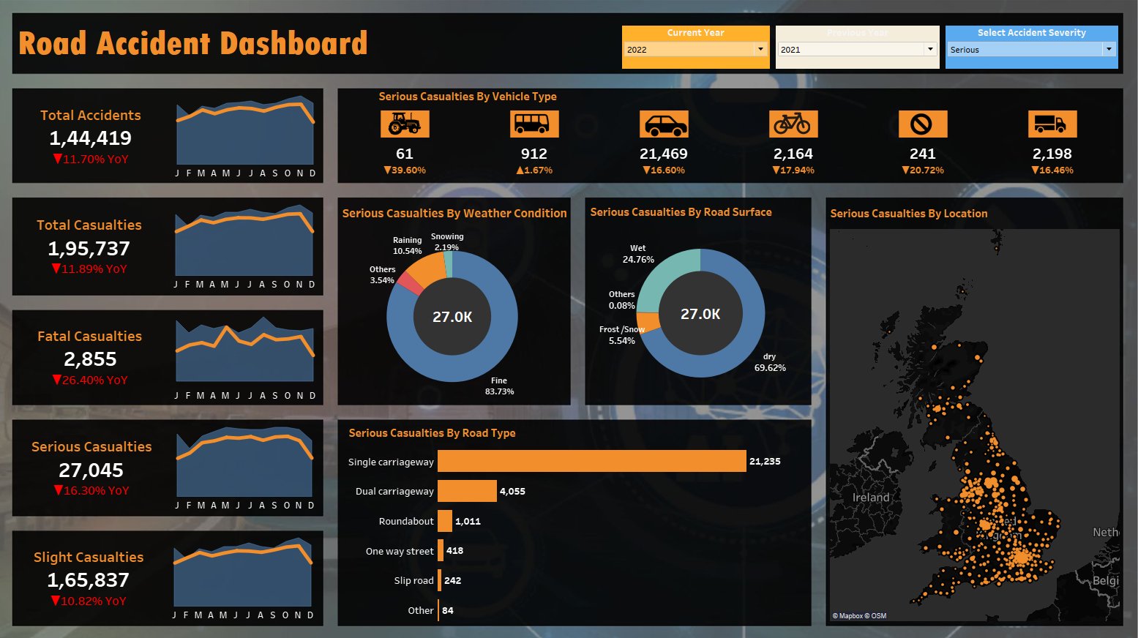
COMPLETE DASHBOARD
ROAD ACCIDENT

Slide 6

Total Accidents
What It Shows: The total number of road accidents in 2022 is 144,419, reflecting an 11.70% YoY decrease. The line chart shows monthly trends, with accident counts rising and falling throughout the year.
Insights: Accidents are highest between July and September, potentially due to seasonal factors like increased travel during summer holidays. The decline toward the end of the year could be linked to reduced travel or weather conditions discouraging road use.

Slide 7
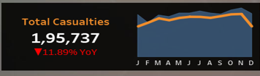
Total Casualties
What It Shows: The total number of casualties for 2022 is 195,737, showing an 11.89% YoY decrease. Monthly trends closely follow the total accidents chart.
Insights: A strong correlation exists between accidents and casualties, as casualties peak during the same months (July to September). This suggests that reducing accidents during these months could have the most impact on casualty numbers.

Slide 8
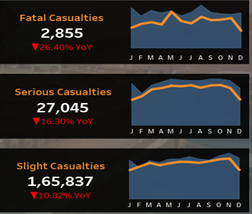
Casualties by Incident Severity
What It Shows:
Fatal casualties in 2022 are 2,855, showing a 26.40% YoY decrease.
Serious casualties total 27,045, with a 16.30% YoY reduction.
Slight casualties are 165,837, reflecting a 10.82% YoY decline.
All three casualty types follow similar monthly trends, peaking between July and September and tapering off toward the end of the year.
Insights: Fatalities are the least frequent but the most severe, while slight casualties are far more common but less severe. The consistent peaks across all types during mid-year suggest seasonal influences like increased road usage in summer. The steady YoY decline across all categories highlights improvements in road safety measures, though fatal and serious casualties show a greater rate of reduction compared to slight ones

Slide 9


Casualties by Vehicle Type
What It Shows: Casualties are categorized by vehicle type, with a breakdown of cars (21,469), bicycles (2,164), buses (912), and others. The severity filter allows users to analyze casualties for different levels (e.g., Fatal, Serious, or Slight), dynamically updating the values based on the selected category. For example, when the filter is set to "Serious," cars dominate the casualty numbers, while bicycles and motorcycles also show notable contributions.
Insights: Cars contribute the highest number of casualties across all severity levels, making them the primary focus for road safety interventions. The filter enables stakeholders to focus on specific severity categories (e.g., Fatal casualties for in-depth risk assessment) to identify patterns and prioritize vehicle-specific measures, such as improving driver safety, enforcing speed limits, or targeting vulnerable road users like cyclists.

Slide 10
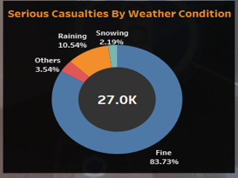
Casualties by weather Condition
What It Shows: Weather conditions during serious accidents are categorized. Most serious casualties occur in fine weather (83.73%), followed by raining (10.54%), snowing (2.19%), and others.
Insights: Contrary to assumptions, fine weather conditions account for the majority of serious casualties, likely due to higher traffic volumes and higher speeds in good driving conditions. Poor weather contributes less but still poses a risk.

Slide 11
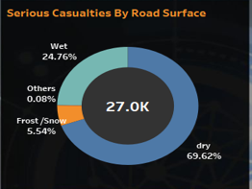
Casualties by Road Surface
What It Shows: Road surface conditions at the time of accidents are categorized. Most casualties occur on dry roads (69.62%), followed by wet roads (24.76%), frost/snow (5.54%), and others.
Insights: Dry roads account for the majority of casualties, which may be due to higher traffic speeds or increased travel in such conditions. Wet and icy roads, though less common, may have a higher risk of accidents per journey.

Slide 12
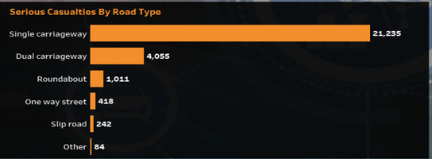
Casualties by Road Type
What It Shows: Distribution of serious casualties by road type, with single carriageways contributing the most (21,235), followed by dual carriageways, roundabouts, and others.
Insights: Single carriageways are significantly more hazardous, likely due to factors like narrower lanes, fewer barriers, or mixed traffic. Focused interventions on these roads could help reduce serious casualties.

Slide 13
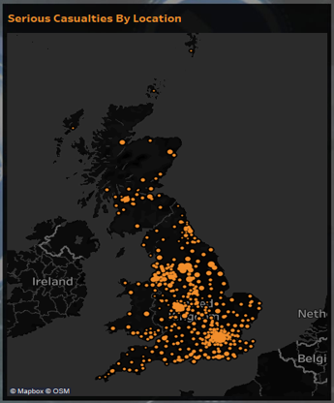
Casualties by Location
What It Shows: Geographical distribution of serious casualties across the UK. The map highlights areas with higher concentrations of accidents.
Insights: Certain regions experience significantly higher casualty rates, which could be linked to population density, traffic volumes, or infrastructure challenges. This visual helps identify accident hotspots for targeted road safety campaigns.

Slide 14

Accident Severity Filter
The Incident Severity Filter dynamically adjusts the visuals for Vehicle Type, Road Surface, Road Type, and Location, allowing users to analyze data based on the selected severity—Fatal, Serious, or Slight. For vehicle types, it highlights how cars dominate in serious and fatal casualties, while bicycles and pedestrians contribute more to slight injuries. In road surface analysis, fatal and serious casualties are more common on wet or icy roads, while dry roads see a higher share of slight incidents. For road types, single carriageways often show the highest fatalities, reflecting higher risks due to speed and design, while slight casualties are more evenly spread across all types. The map visualization updates to show hotspots for each severity, with fatal accidents often concentrated in rural or high-speed areas and slight casualties in urban, high-traffic zones. This filter enables focused analysis, helping identify severity-specific patterns and prioritize targeted safety measures.

Slide 15
Insights
The dashboard demonstrates a steady decline in road accidents and casualties, indicating the success of ongoing safety measures.
However, peaks between July and September suggest seasonal risks, likely driven by increased travel during summer months.
Cars are the primary contributors to casualties across all severity levels, with single carriageways being the most hazardous road type, especially for fatal and serious incidents.
Most accidents occur in fine weather and on dry roads, highlighting the impact of driver behavior and traffic volume rather than adverse environmental conditions.
Urban areas report a higher number of slight casualties due to dense traffic, while fatal incidents are more common in rural regions.
The dynamic severity filter adds granularity to the analysis, enabling stakeholders to focus on specific severity levels and identify patterns for targeted interventions.

Slide 16
Conclusion
The dashboard demonstrates a positive overall trend in reducing accidents and casualties, reflecting the effectiveness of ongoing road safety initiatives.
However, specific areas require further attention, such as reducing peaks during summer months, improving safety on single carriageways, and protecting vulnerable road users.
The use of dynamic filters, such as the severity filter, enhances the granularity of analysis, empowering stakeholders to identify critical risk factors and implement targeted measures.
By addressing these insights, further reductions in road accidents and casualties can be achieved, making roads safer for all users

Slide 17
THANK YOU

